Slide 1
JIGSAW CAPSTONE PROJECT PYTHON
Students’ Early Attrition Modelling for Clearwater State University

Slide 2
PROJECT DESCRIPTION
Clearwater State University offers a wide variety of degree programs, from online degrees to a doctorate in education.
Programs are offered in the streams of the arts, education, business & nursing.
Some key strategic goals of the University are:
• Increase enrolment of students
• Improve retention, progression and graduation rates
• Recruit better academically qualified undergraduate and graduate students
• Increase external funding and recognition

Slide 3
PROBLEM STATEMENT
Identify key drivers of early student attrition
Build a predictive model to identify students with higher early attrition risk
Recommend appropriate interventions based on the analysis

Slide 4
Business Questions
1. Identify key drivers of early student attrition
2.Build a predictive model to identify students with higher early attrition risk
3. Recommend appropriate interventions based on the analysis

Slide 5
ANSWERING BUSINESS QUESTIONS
Identifying key drivers of early student attrition.
Ans: In this case study, "Student Applications & Performance.xlsx" dataset was sourced from Clearwater State University Students Attrition & Performance which contains students data for 3400 students with various information about the students.
In this data 'RETURN_2ND_YR' variable is the target variable and based on this variable I had performed some data analysis which showed me how other variables are in line with the target variable.

Slide 6
Continued.......
Some of the attributes which are key drivers of attrition are,
Distance from University to student's home. -----'DISTANCE_FROM_HOME'.
Course Fees --------'COST_OF_ATTEND'.
High school GPA score -----'HIGH_SCHL_GPA'.
Students Age and Student's score calculated both on Entrance1 & Entrance2 score ------'STDNT_AGE', 'STDNT_ENTRANCE_MARKS_COMBINED'.
Both Father and Mother education Status and Students Background.
Also students gender.
Students living inside state, outside state etc.

Slide 7
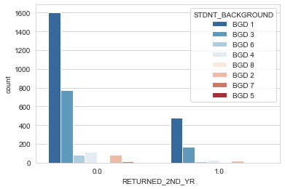
Continued...
The following plot represents the counting of students who are returned for First Sem in 2nd year based on their background.
BGD1 category shows more attrition rate where as BGD5 shows less.

Slide 8
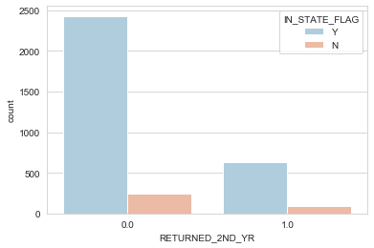
Continued......
The following figure describes count of student's who's state is also same as the university and returned for First Sem in the 2nd year education.

Slide 9
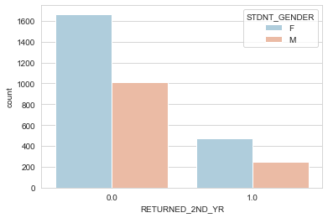
Continued.........
The following figure describes Students who returned for College based on their Gender.
Where F represents female students.
M represents male students.

Slide 10
Continue.......
2. Build a predictive model to identify students with higher early attrition risk.
Ans: I have created a predictive model to identify students with higher early attrition risk. The model was created using "Gradient Boosting Classifier" algorithm and from the following model we calculated and look into the specific feature variables which are impacting our targeted variable in the model.
Some of the key variables which are impacting the predictor variable are as follows:

Slide 11
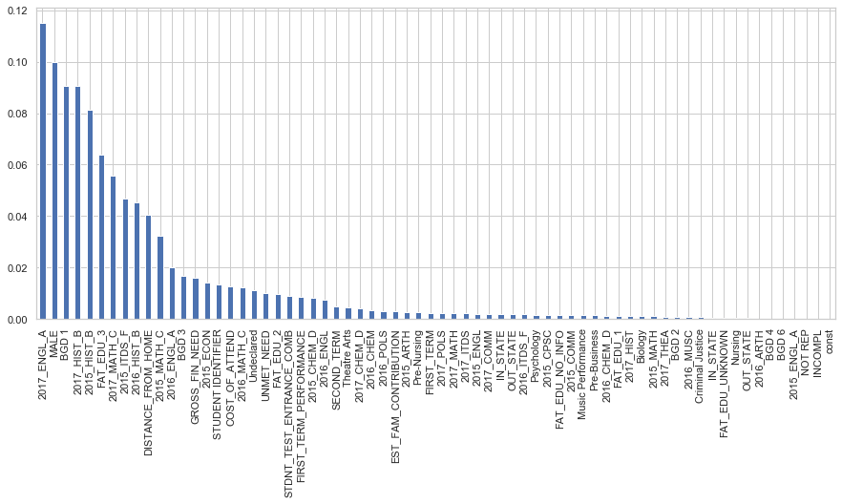
Continued.......

Slide 12
Students with higher attrition risk...
The model shows variable 2017_ENGL_A has beta co-efficient of 0.115265 which means that a unit increase in the variable affects target variable by 0.115265 times.
Which means students who scored A grade in core course name 3 exam in which students studying subject English who took grade A where most likely to contribute for attrition. A unit change in this will increase attrition by 0.115265 units.
The model also shows that variable 'MALE' has beta co-efficient of 0.100052 .
Which male students are more likely to contribute for attrition than female students. A unit change in this variable will increase attrition by 0.100052 units.

Slide 13
Continued.......
The model shows variable BGD 1 has beta co-efficient of 0.090599 which means that a unit increase in the variable affects target variable by 0.090599 times.
Which means students with background of category 1 where most likely to contribute for attrition. A unit change in this will increase attrition by 0.090599 units.
The model shows variable 2017_HIST_B has beta co-efficient of 0.090554 which means that a unit increase in the variable affects target variable by 0.090554 times.
Which means students scored History subject with B grade in Core course grade 3 where most likely to contribute for attrition. A unit change in this will increase attrition by 0.090554 units.

Slide 14
Other key variables with more attrition risk factor

Slide 15
Continued......
3. Recommend appropriate interventions based on the analysis
Based on the model we developed the following measures can be taken.
University must focus on students who obtained A grade in English subject in core course name 3 exam in 2017 batch. Because based on the model statistically they are highly likely to contribute for attrition. Therefore the following students must be taken care very well as well as improving the course curriculum and teaching methodology will be key for improving retention in admission for the upcoming years.

Slide 16
Continued...
2. Also Male students were more likely to contribute for attrition. So Parents and University must primarily focus on male students with age 18, should be taken care of academically. Statistically they are contributing 0.100052 unit for students attrition.
And also special classes and better faculty support can be given for them to improve their mental and physical will and academic performance. Using technology can be helpful for them to understand better and learn in faster way.
3. The model shows student with level 1 Background have more likely to contribute for attrition and therefore special provisions must be given to them. Especially financial need and academic support.
By giving proper residential facility to them will stabilize them as well as improves the retention rate of the university.

Slide 17
Continued......
4.University must focus on students who opted History subject and secured B grade in core course name 3 and core course name1 exams in 2017 and 2015 batch respectively. Because based on the model they are likely to contribute for attrition. Therefore the following students must be taught very well as well as improving the course curriculum and teaching methodology will be key for improving retention in admission for the upcoming years.
University must pick students whose parents having better educational background. And also students with native origin over far home students. Students with home outside locality will contribute more for attrition. Also parents with low educated background whose students are more likely contributing. Therefore university must focus on parents education as well.

Slide 18
*******
THANK YOU

